Slide 3
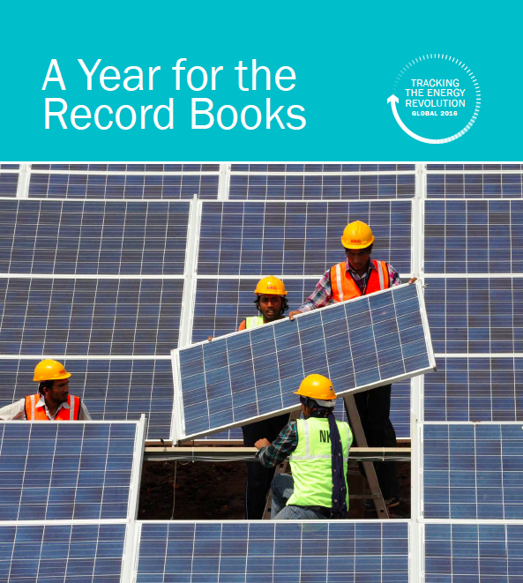
Outline
Introductions
Overview of Global Trends
Panel Discussion
Audience Q&A
Duration: 60 minutes

Slide 11
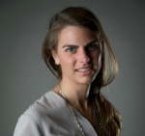
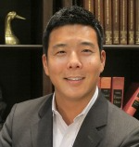
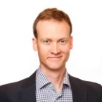
Our Panelists
Pictured above (left to right):
Amy Grace, Bloomberg New Energy Finance (@AmyGraceWind)
Hando Kang, SkyPower Global (@HandoKang)
Dan Woynillowicz, Clean Energy Canada (@danwoy)
Julia Kilpatrick, Clean Energy Canada (@juliakilpat)
Join the conversation by using #CEQuarterly

